Slide 1
Project Quality Management
Ch9

Slide 2
Introduction
Quality is defined by the International Organization for Standardization (ISO) as all the characteristics of an entity that bear on its ability to satisfy stated or implied needs.
Other organizations define quality as conformity to requirements in meeting written specifications and ensuring that a product is fit to use as it was intended.

Slide 3
PROJECT QUALITY MANAGEMENT PROCESSES
Project quality management processes take place during the planning, execution, and control phases of project management
Quality planning process, which takes place during the planning phase, identifies which quality standards are relevant to the project and how to satisfy them.
Quality assurance is done throughout the execution phase to evaluate the overall project performance, and to ensure the project (product) satisfies the applicable quality standards while identifying ways to improve overall quality
Quality control is accomplished during the controlling phase by monitoring specific project (product) results to ensure that they comply with the relevant quality standards.

Slide 4
The basic requirements or objectives of quality management include:
1. the requirement for customer satisfaction,
2. preference for prevention over inspection, and
3. recognizing that management has the responsibility for quality.

Slide 5
QUALITY PLANNING
Project managers should recognize the importance of considering quality in the very early stages of a product design and in communicating important factors that directly contribute to meeting

Slide 6
PROJECTMANAGEMENT FOR ENGINEERINGDESIGN
The customer’s requirements. Often during the feasibility phase, project teams may have to design experiments that can help in identifying which variables have the most influence on the overall outcome of a process.
The project manager should keep in mind that many scope aspects of projects may affect quality, i.e., functionality, features, system outputs, performance, reliability, and maintainability.

Slide 7
QUALITY ASSURANCE
Quality assurance includes all the activities related to satisfying the relevant quality standards for a project; however, another goal of quality assurance is to provide continuous quality improvement.
For example, benchmarking can be used to generate ideas for quality improvements, and quality audits can help identify lessons learned that may be used to improve performance on current or future projects.

Slide 8
QUALITY CONTROL
Quality control in essences requires testing or monitoring a specific product to ensure compliance with quality standards. The main outputs of quality control include making an acceptance decision on whether the product met required specifications and standard or it did not.
If the product does not meet the quality standards then the product must be rejected for “rework” and/or the production process must be reviewed and perhaps require adjustments.

Slide 9
Some tools and techniques used in quality control include:
1. Pareto analysis
2. statistical sampling
3. quality control charts
4. testing.

Slide 10
Pareto Analysis: Pareto analysis involves identifying the principle factors that account for the most quality problems in a system. Pareto analysis is also called the 80–20 rule, which means that 80% of problems are often due to 20% of the causes (factors). To help identify and prioritize problem areas in a system, Pareto diagrams or histograms are used by management personnel

Slide 11
Quality Control Charts : Quality control charts graphically display quality data to show the results of a process over time, thus helping to determine if the process is in control or out of control, and to prevent product defects. One of the quality control charts examines the process for nonrandom problems through the application of the “Seven Run Rule,” which states, “If seven data points in a row are all below the mean, above the mean, increasing, or decreasing, then the process needs to be examined for non-random problems.”

Slide 12
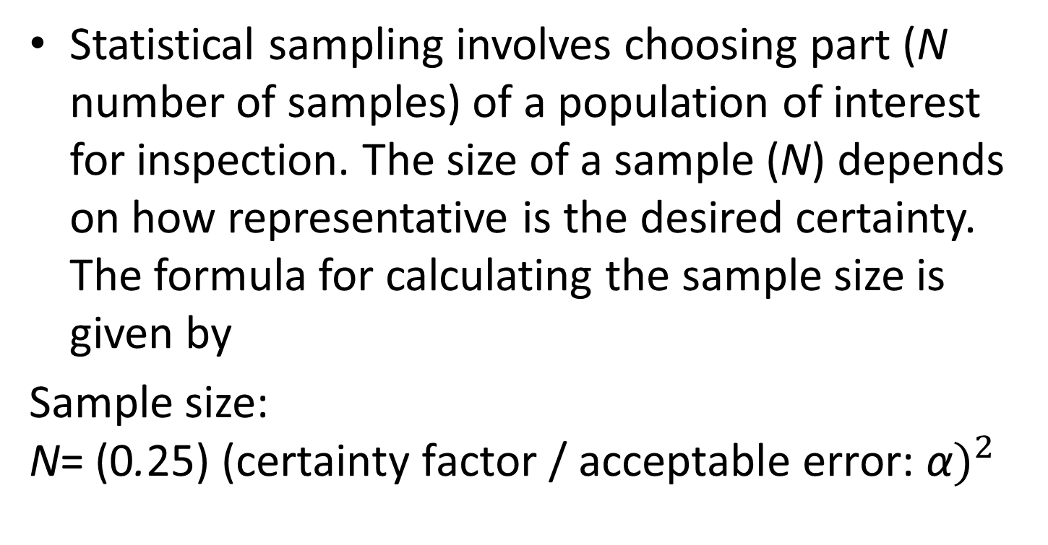
Statistical Sampling and Standard Deviation:
Statistical sampling involves choosing part (N number of samples) of a population of interest for inspection. The size of a sample (N) depends on how representative is the desired certainty. The formula for calculating the sample size is given by
Sample size: N${\text{= (}\text{0}\text{.}\text{25}\text{) (}\text{certainty} \text{factor}\text{ / }\text{acceptable} \text{error}\text{: }\text{α})}^{2}$

Slide 13
Basic Statistical Measures
Most college students are familiar with basic descriptive statistics, e.g., mean, median, mode, variance, and standard deviation. The standard deviation (σ) is a measure of how much variation exists in a distribution of data.
A small standard deviation means that data are clustered closely around the middle of a distribution and that there is little variability among the data.

Slide 14
Testing:
Testing is one of the quality management functions that should be done during almost every phase of the product development life cycle; even though some managers prefer to think of testing as a stage that follows at the end of the product development process.

Slide 15
IMPROVING PROJECT QUALITY
A goal of quality assurance is to provide continuous quality improvement. Various suggestions have been offered for improving the quality of projects which include that program managers and organizational leadership should understand the cost of quality, and promote a quality environment and frame of mind.

Slide 16
COSTOF QUALITY
Five types of cost are generally cited:
1. Prevention cost, which includes the cost of planning and executing a project so that it is error-free and/or within an acceptable error range.
2. Appraisal cost, which takes into account the cost of evaluating processes and their outputs to ensure quality.
3. Internal failure cost, which is the cost incurred to correct an identified defect before the customer receives the product.
4. External failure cost, which relates to all errors not detected and corrected before delivery to the customer. Keep in mind that these costs may include recalls and liability suites.
5. Measurement and test equipment costs, which include the capital cost of equipment used to perform prevention and appraisal activities.

